Slide 1
U.S. Unemployment Rate (2018 - 2022)
Crisaldry Brito • Ivan Galeano • Angela Narag

Slide 2
Agenda
Executive Summary
Data Collection - Clean Up - Exploration
Project Approach
Results of the Analysis
National Unemployment Rate
Unemployment by U.S. States
Unemployment by Industry
Covid19 and Unemployment
CPI and Unemployment
Conclusion / Next Steps
Notes:
Crisaldry

Slide 3
Executive Summary
Project Focus: U.S. Economic Data with focus on Unemployment Rates
Project Goal: Analyze the unemployment rates across the U.S. within the last 5 years with a deeper look at unemployment at the state level and other U.S. industries.
Notes:
Crisaldry

Slide 4
All About the Data
Collection - Clean Up - Exploration
Data Sources:
Bureau of Labor Statistics
FRED
Kaggle.com
Geoapify
Data Collection, Clean-up and Exploration:
Use of multiple APIs for Unemployment Rates and Geographical Coordinates
Combining data into DataFrames and CSV files
Clean-up included filling in missing data, renaming/ordering columns, converting data types, etc.
Use of additional resources to support the analysis
Notes:
Ivan:
Data Collection: The data on unemployment rates can be obtained from various sources, including government agencies such as the Bureau of Labor Statistics (BLS) or the Department of Labor. The data can be collected through surveys, administrative records, or online sources.
Data Cleaning: Once the data has been collected, it is important to clean and pre-process it to ensure accuracy and consistency. This involves several steps such as:
Removing duplicate records
Handling missing values
Checking for outliers and errors in the data
Converting data into a consistent format
Standardizing the data, for example, converting unemployment rates into a common time scale (monthly, quarterly, etc.)
APIs: APIs (Application Programming Interfaces) are tools that allow for the exchange of data between different systems. They can be used to access and extract unemployment data from various sources. The APIs typically provide a simplified way to access data, allowing developers to easily access the data they need in a format that is easy to use and manipulate. Some examples of APIs that provide access to unemployment data include the BLS API, the U.S. Census Bureau API, and the FRED API.

Slide 5
Project Approach and Challenges
Understanding the BLS data structure and finding the correct data to use for our thesis and analysis, taking into consideration the multiple ‘filter’ needed to get the date ‘series IDs’ required.
After gathering the data, the next challenge encountered included merging the multiple data points from the one API into a CSV file for the entire group.
Once that data was analyzed, the last challenge was finding a cohesive narrative and supplemental data to meet the project goal.
Notes:
Angela
When we decided to do our project on Unemployment Rates, we agreed that the Bureau of Labor Statistics will be a credible datasource
It was a challenge to find the exact data needed on the BLS website especially since the use “series IDs” to identify different datapoints
Once all the seriesIDs were identified, the next challenge was to merge the multiple data points into one API and CSV file for the entire group to use
After we analyzed our data, our team had to find a cohesive narrative for our project and supplemental data to meet our project goal

Slide 6
Results of the Analysis

Slide 7
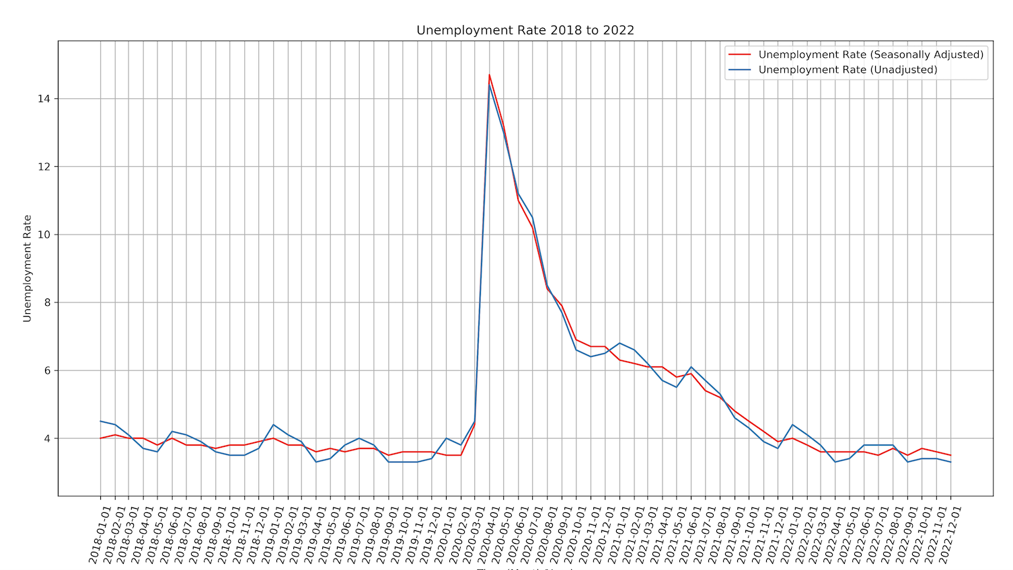
U.S. National Unemployment Rate (2018 – 2022)
U.S. unemployment was at a low of 3.5% in February 2020 before a sharp increase to 14.7% in April 2020.
There is consensus that the Covid19 pandemic had significant impact on the labor market leading to widespread job losses.
Throughout 2020, unemployment steadily declined from its peak to 6.7% in December 2020 and is back to 3.5% in December 2022
Seasonally adjusted is a modified version on unadjusted that eliminates the effects of predictable seasonal changes - like weather, holidays, school schedules - and provides a clearer picture of underlying trends. In general, seasonally adjusted unemployment rates are considered a more accurate representation of the labor market
Notes:
Angela
We collected the National Unemployment Rate from 2018 to 2022
On this chart, we plotted both Seasonally Adjusted and Unadjusted Unemployment Rates to show that although there are some differences, both have pretty much the same peaks and troughs
On this chart we can see that unemployment was in February 2020 before a sharp increase in April 2020
There is consensus the sharp increase is due to Covid19 pandemic

Slide 8
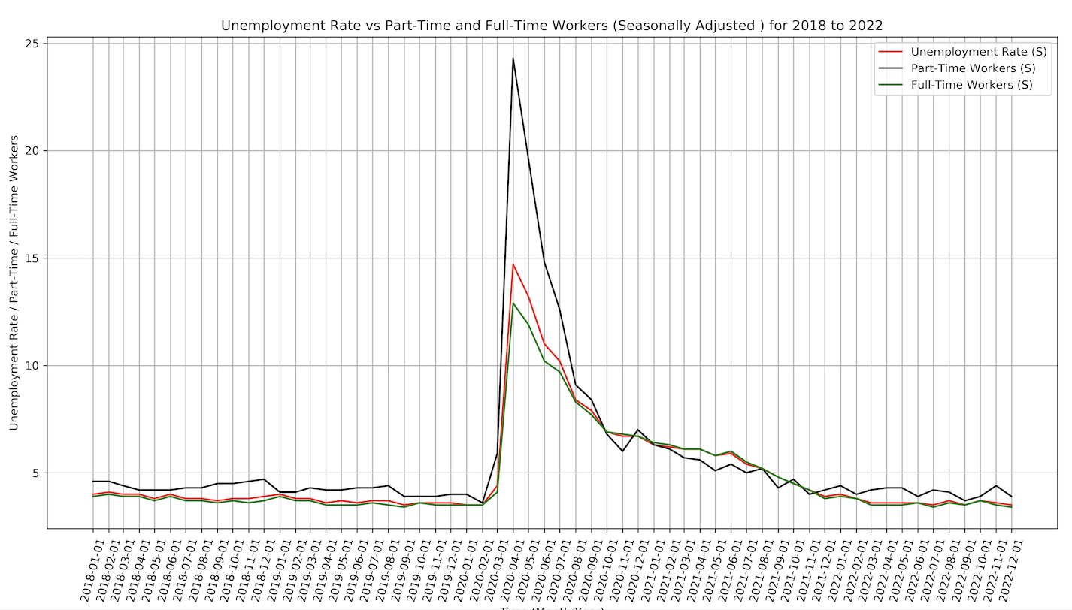
Unemployment Rate: Part-Time and Full-Time Workers
Part-Time workers were disproportionately impacted by the Covid19 shutdowns
At the peak, the Part-Time workers unemployment rate was 24.3% compared to Full-Time workers at 12.9% and the national rate of 14.7%
Part-time workers are often concentrated in industries that were heavily impacted by the shutdowns, such as retail, hospitality, and leisure.
Part-time workers are less likely to have the option to work from home, as many part-time jobs are in industries that require in-person work.
Notes:
Angela
Here we further look at the seasonally adjusted unemployment rates for Part-Time and Full-Time Workers against the National Unemployment Rate
We can see the at the peak, the Part-Time workers unemployment rate was 24.3% compared to Full-Time workers at 12.9% and the national rate of 14.7%
Part-time workers are often concentrated in industries that were heavily impacted by the Covid19 shutdowns, such as retail, hospitality, and leisure. They also work in industries that require in-person work and are not likely to have options for remote work.

Slide 9
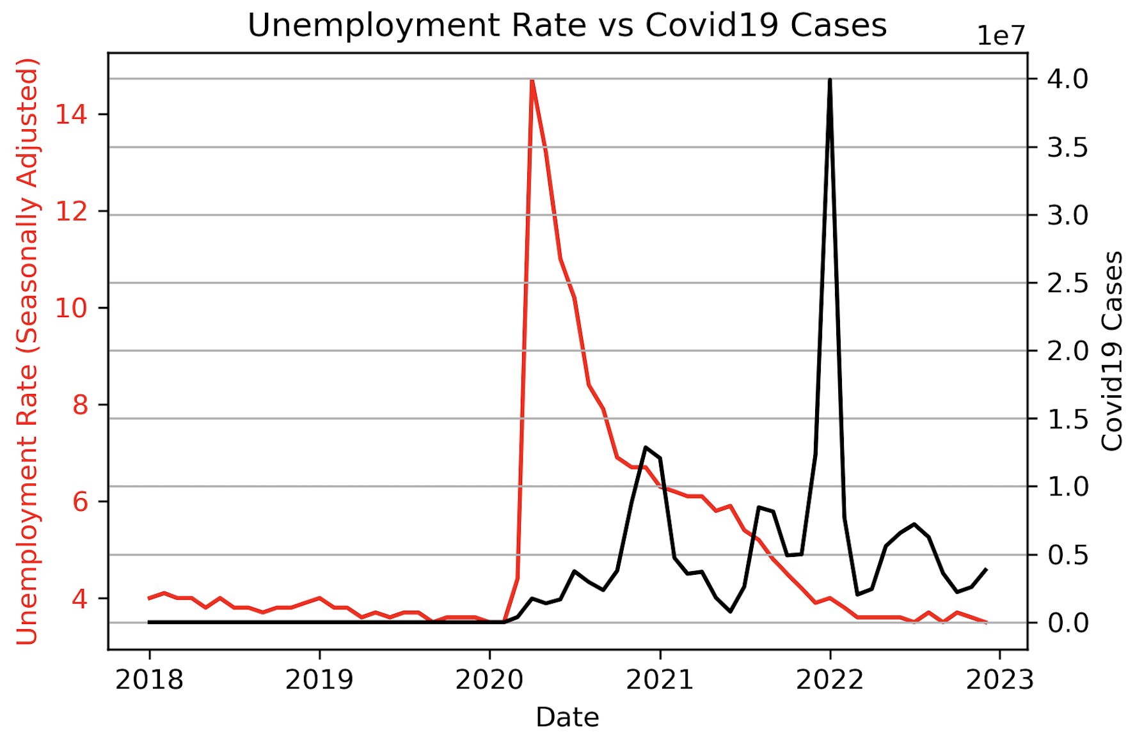
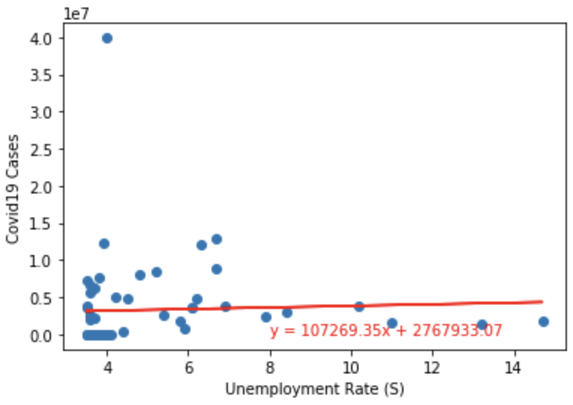
Covid-19 And Unemployment
Based on the Pearson’s Correlation, Unemployment Rates and Covid19 Case count have a correlation coefficient of 0.04 which means there is no correlation, or it is very weak. However, according to an online article published by the Bureau of Labor Statistics on June 2021, "...[a] decade-long economic expansion ended early in 2020, as the coronavirus disease 2019 (COVID-19) pandemic and efforts to contain it led businesses to suspend operations or close, resulting in a record number of temporary layoffs. The pandemic also prevented many people from looking for work."
Therefore, simply comparing the number of Covid19 cases by itself to the Unemployment Rate is not enough to show correlation. We must also look at other factors such as industry, state, number of remote workers, etc. to understand the causes of unemployment.
Notes:
Angela
On this chart, we wanted to prove correlation of covid19 cases with unemployment rates. We calculated the Pearson’s Correlation Coefficient of 0.04 which is less than 0.3, meaning it either has none of very weak
However, according the Bureau of Labor Statistics, the nationwide shutdowns resulted in a record number of temporary layoffs and prevented many people from looking for work
Therefore we cannot simply compare number of Covid19 cases to the unemployment rate, we need to look at other factors such as industry, geography, and more, to understand the what caused unemployment
Note: r <0.3 means NONE or very weak

Slide 10
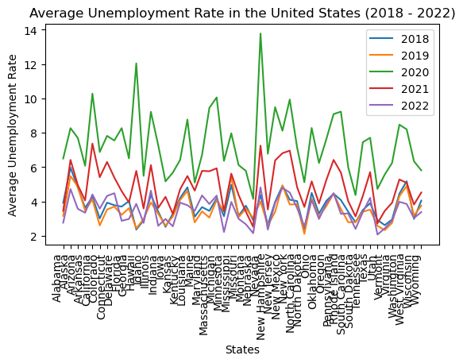
Unemployment Rate By State
As can be seen in the graph, for the last 5 years (2018 - 2022), the U.S has seen dramatic changes in the unemployment rates by states.
During 2020, the unemployment rate across all 50 states saw an increase. According to the Bureau of Labor Statistic, the spike in unemployment in 2020 was due to the Covid Pandemic that led to worldwide shut down. During the pandemic businesses were forced to suspend operations, close, and/or temporary lay off workers.
In 2021, the unemployment rate began to slowly decrease as business began to reopen, stimulating the economy.
By 2022, the overall unemployment rate trend began to return to similar pre-pandemic rates. unfortunately, not all states have been able to return to their pre-pandemic rates, while others have been able to reach, if not lower their pre-pandemic unemployment rates.
Notes:
Crisaldry

Slide 11
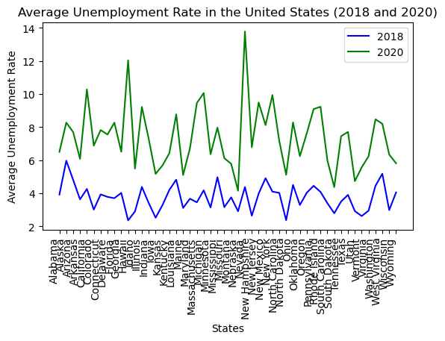
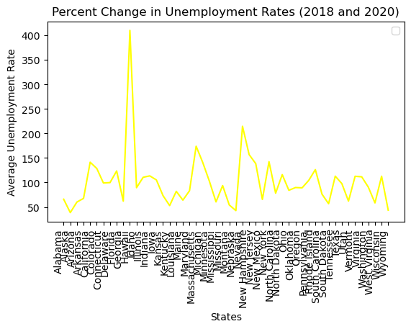
Pre-Pandemic Unemployment Rate Across The U.S. States (2018 - 2020)
On average between 2018 and 2020, the unemployment rate in the United States rose by 101.54 percent, with exception of Hawaii. Between these two years, Hawaii’s unemployment rate rose by 410.17 percent.
Comparatively, between 2018 and 2020, the unemployment rate rose amongst all 50 states.
Notes:
Crisaldry

Slide 12
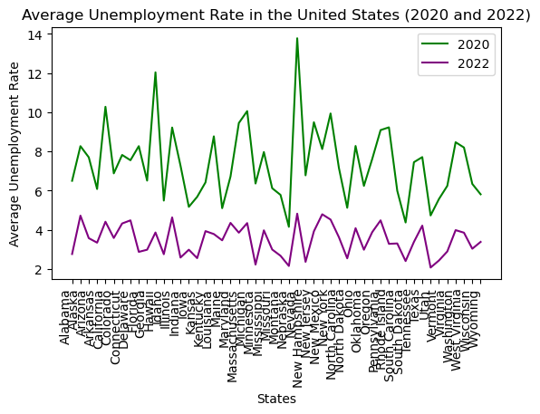
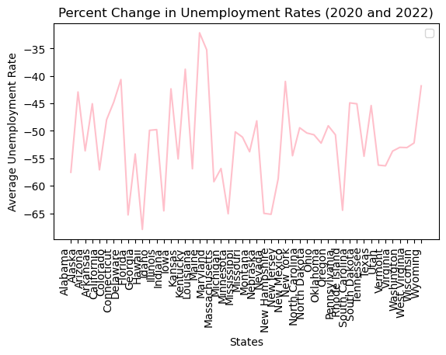
Post-Pandemic Unemployment Across The U.S. States (2020 - 2022)
Between 2020 and 2022, the unemployment rate across all 50 states began to normalize to pre-pandemic rates.
On average between 2020 and 2022, the unemployment rate in the United States decreased by -51.89 percent, with Hawaii displaying the greatest decrease with -67.94 percent.
Notes:
Crisaldry

Slide 13
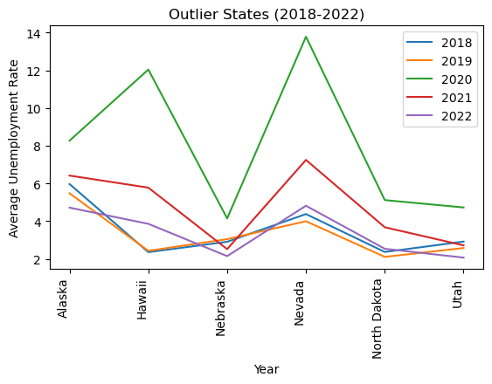
Unemployment Across The U.S. States: Outliers
The state with the minimum average unemployment rate in 2018 is Hawaii with a rate of 2.36
The state with the maximum average unemployment rate in 2018 is Alaska with a rate of 5.97
The state with the minimum average unemployment rate in 2019 is North Dakota with a rate of 2.11
The state with the maximum average unemployment rate in 2019 is Alaska with a rate of 5.48
The state with the minimum average unemployment rate in 2020 is Nebraska with a rate of 4.15
The state with the maximum average unemployment rate in 2020 is Nevada with a rate of 13.78
The state with the minimum average unemployment rate in 2021 is Nebraska with a rate of 2.52
The state with the maximum average unemployment rate in 2021 is California with a rate of 7.37
The state with the minimum average unemployment rate in 2022 is Utah with a rate of 2.07
The state with the maximum average unemployment rate in 2022 is Nevada with a rate of 4.82
Notes:
Crisaldry

Slide 14
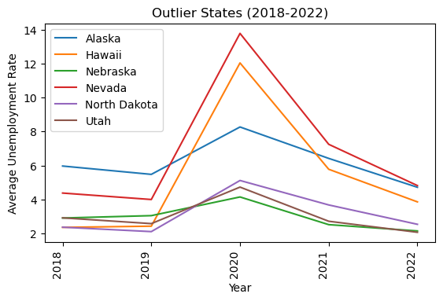
Unemployment Across The U.S. States: Outliers
The line graph shows the 7 outliers states that experienced the most fluctuation in unemployment rate in the last 5 years.
States like Hawaii, went from being the state with the lowest unemployment rate in 2018, to the state with the highest unemployment rate in 2020. While there has been a decrease in the unemployment rate, the country has not yet returned to their pre-pandemic rate.
Alaska, on the other hand was the state with the highest unemployment rate in 2018 and in 2019. Since the 2020 peak, their unemployment rate has continued to decrease, reaching lower than the pre-pandemic rates.
Notes:
Crisaldry

Slide 15
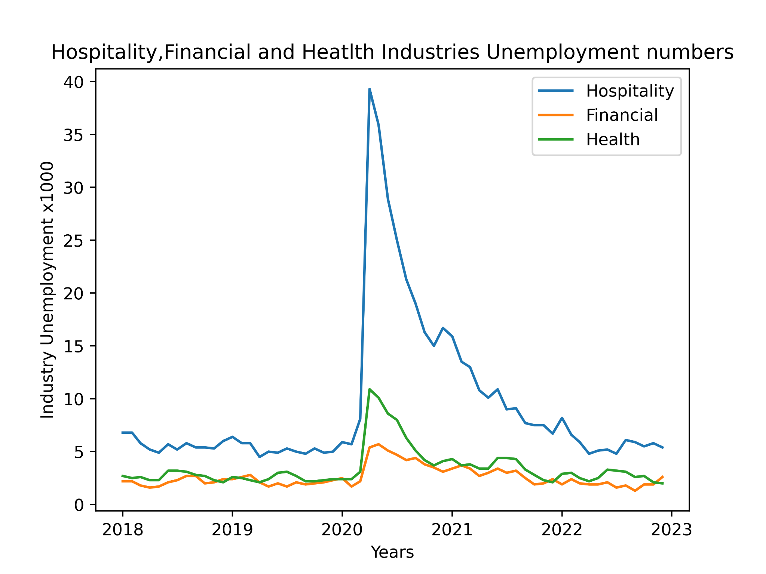
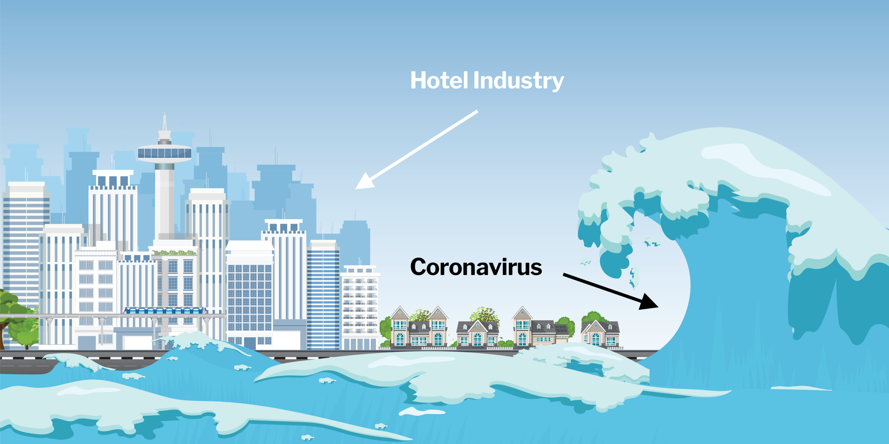


Unemployment Impact For Some Particular Industries
Hospitality
Financial
Hospitality:Travel restrictions and lockdown measures have severely reduced demand for hotels, restaurants, and other related services.
Financial:Unemployment rates have increased, consumer spending has decreased, and businesses have struggled to stay afloat, leading to an overall reduction in demand for financial services. As a result, some companies in the finance industry have implemented cost-cutting measures, including layoffs.
Healthcare: While some areas, such as hospitals and urgent care clinics, have experienced a surge in demand and have had to hire more workers to keep up, other areas, such as elective surgeries, have seen a decrease in demand and have had to reduce staffing levels.
Healthcare
Notes:
Ivan
https://ucarecdn.com/6a384041-e914-45c3-9285-35057b4c8da6/
https://www.knowis.com/hubfs/coronavirus_im_Banking.jpg
https://www.myamericannurse.com/wp-content/uploads/2020/12/nurse-struggle-frontline-covid19-scaled.jpg

Slide 16
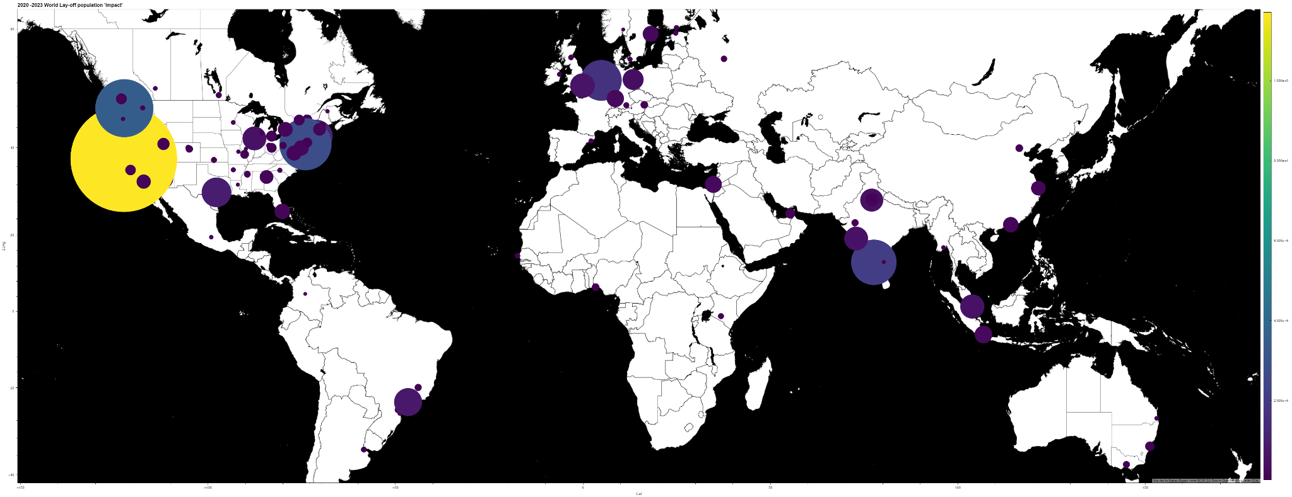
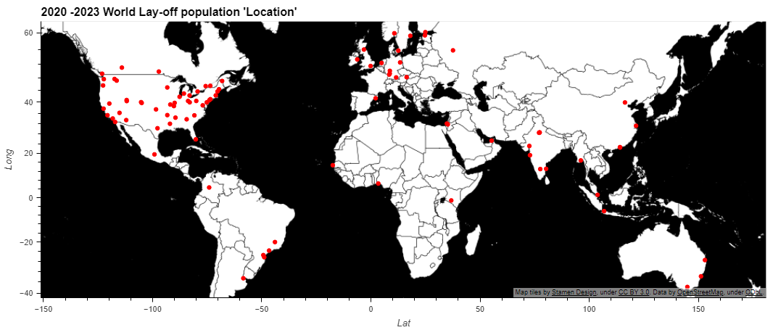
Unemployment & Lay-Offs Vs Us And World Industry
The COVID-19 pandemic has had a significant impact on employment around the world, with many companies and industries experiencing layoffs and job losses.
Unlike layoffs due to COVID-19, which have been caused by an external and unpredictable factor, layoffs due to general financial problems are often caused by broader economic trends and cycles.
Notes:
Ivan
https://ucarecdn.com/6a384041-e914-45c3-9285-35057b4c8da6/
https://www.knowis.com/hubfs/coronavirus_im_Banking.jpg
https://www.myamericannurse.com/wp-content/uploads/2020/12/nurse-struggle-frontline-covid19-scaled.jpg

Slide 17
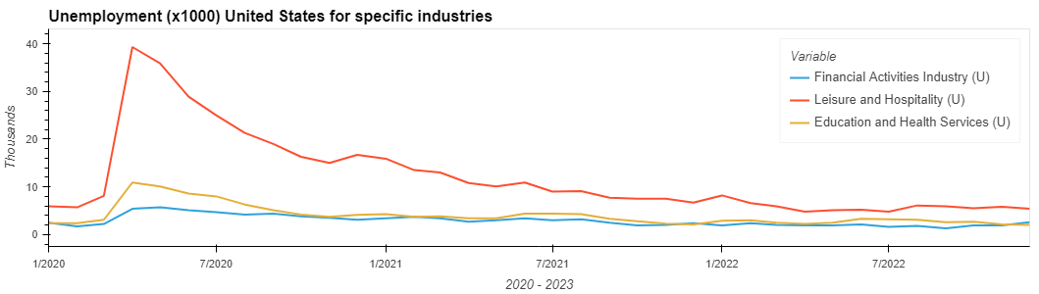
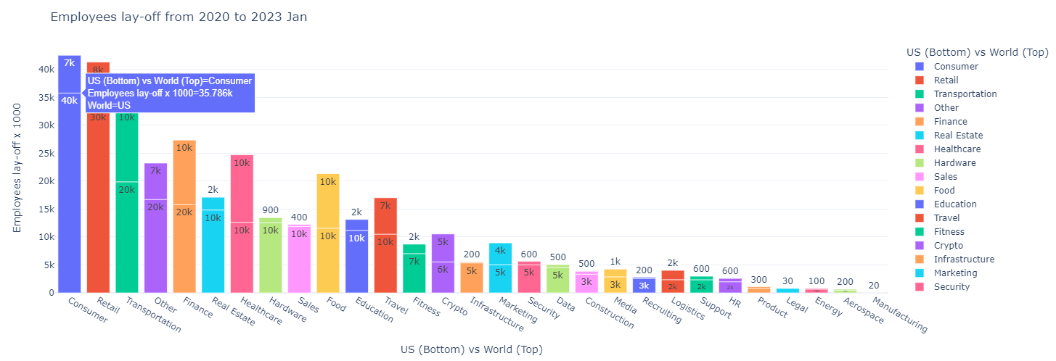
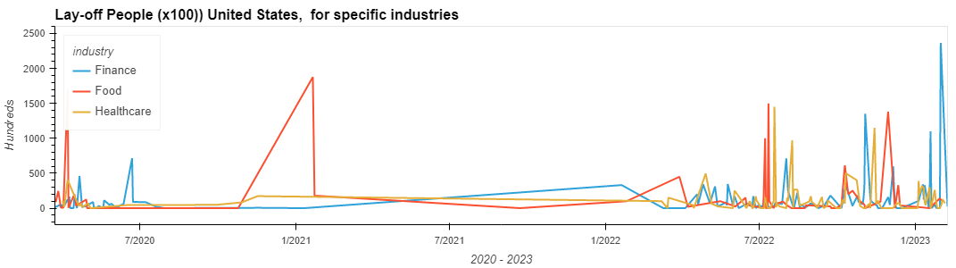
Unemployment & Lay-Offs Vs Us And World Industry
Given the source data the graph shows the US being affected dramatically by the wave of Lay-off’s since 2020.
The Consumer sector has also seen a significant number of layoffs due to the rise of e-commerce, changing consumer behavior and covd aftermath.
Notes:
Ivan
https://ucarecdn.com/6a384041-e914-45c3-9285-35057b4c8da6/
https://www.knowis.com/hubfs/coronavirus_im_Banking.jpg
https://www.myamericannurse.com/wp-content/uploads/2020/12/nurse-struggle-frontline-covid19-scaled.jpg

Slide 18
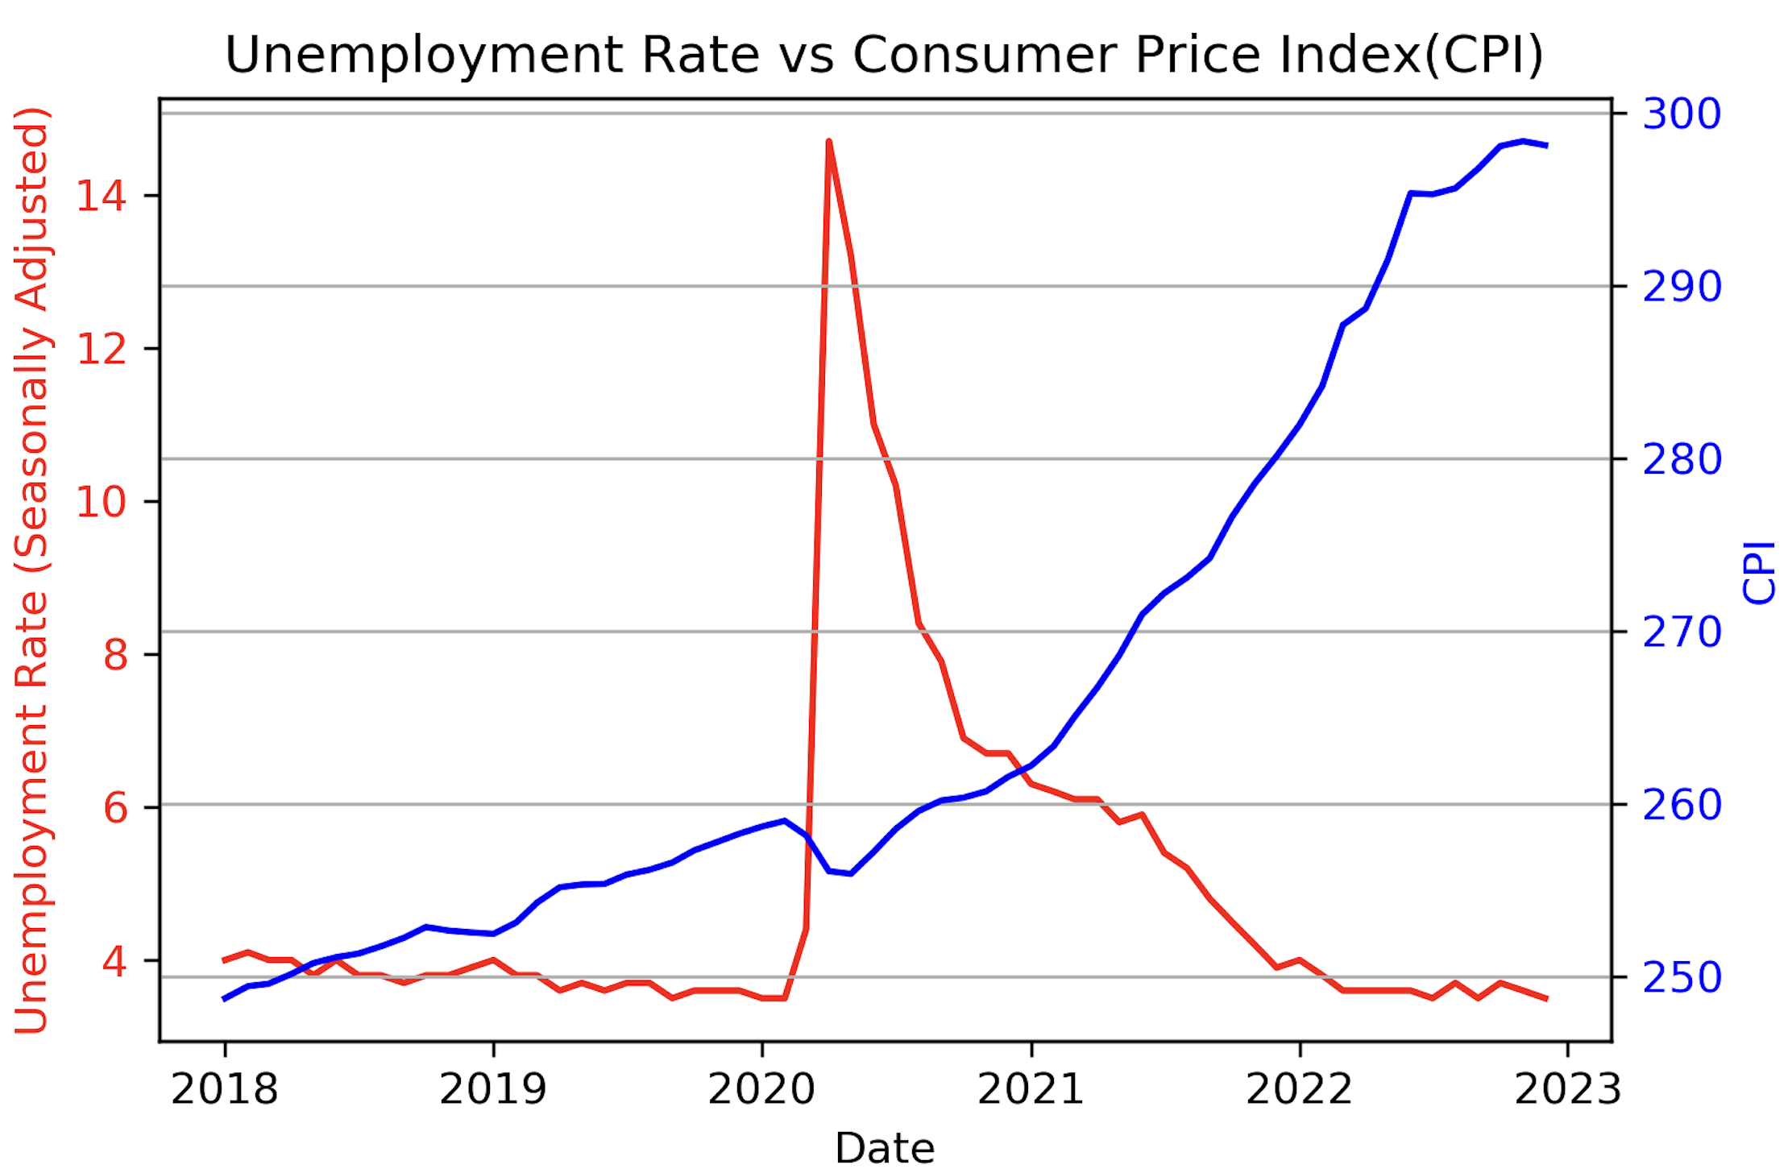
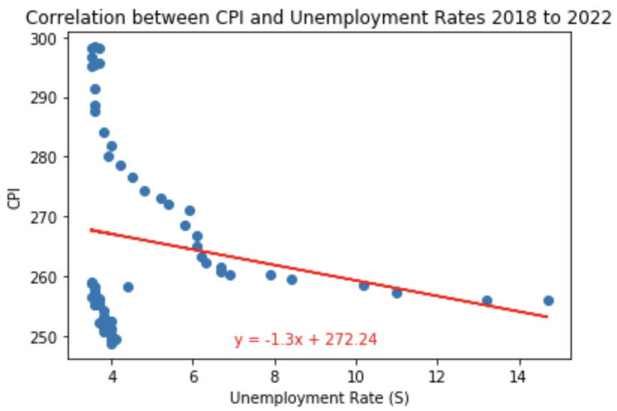
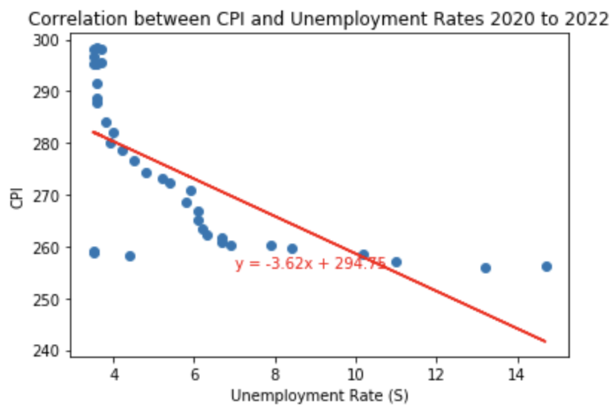
The Consumer Price Index (CPI) and Unemployment
According to a recent CNBC article, the recent layoffs in the technology industry “come in a period of slowing growth, higher interest rates to battle inflation, and fears of a possible recession next year.”
A well-known indicator of inflation is the Consumer Price Index (CPI), a measure of the average change overtime in the prices paid by urban consumers for a market basket of consumer goods and services.
According to Investopedia, although CPI is not a direct indicator, "inflation and unemployment has traditionally been an inverse correlation”.
The correlation coefficient of Unemployment Rate and CPI is -0.2 which proves the negative correlation, but it is still less than < 0.3 which can mean there is no correlation, or it is very weak. However, if you removed 2018 and 2019, and only used date from 2020 to 2022, the correlation coefficient becomes stronger at -0.68.
Notes:
https://www.investopedia.com/articles/markets/081515/how-inflation-and-unemployment-are-related.asp
https://www.bls.gov/cpi/questions-and-answers.htm
https://www.cnbc.com/2023/01/18/tech-layoffs-microsoft-amazon-meta-others-have-cut-more-than-60000.html

Slide 19
DOING NOTHING IS VERY HARD TO DO… YOU NEVER KNOW WHEN YOU’RE FINISHED.
Leslie Nielsen

Slide 20
Conclusion and Next Steps
The sharp rise in unemployment in 2021 can be attributed to the start of Covid-19 pandemic. However, only comparing Covid-19 cases and Unemployment Rates show a weak correlation based on Pearson’s correlation. We must look at other data points such as Unemployment by State and Industry to support that Covid19 made a large impact to the unemployment rate.
From 2018 to 2022, the U.S experienced extreme fluctuation in the unemployment rates. Each state saw an average of 101.54% increase in the unemployment rate, due to the Covid-19 Pandemic. Each state experienced the pandemic differently, with some state’s unemployment rate rising as high as 13.7%.
As business began to reopen and people returned back to work, the unemployment levels began to return to their pre-pandemic levels. Although many states are continuing to struggle to return to those levels and continue to experience high levels of unemployment.
The pandemic has led to a significant increase in unemployment rates and layoffs, particularly in industries such as hospitality, Financial, and healthcare. This has had a significant impact on the US economy, with millions of workers being Lay-off and struggling to make ends meet. All of this perfect storm created Economic Challenges for the US economy. Now in 2023 we are seeing a higher impact of Layoffs, most likely the result of our current economic challenges.
Notes:
Angela
Crisaldry
Ivan

Slide 21
THANK YOU
Crisaldry Brito: Crisaldry@gmail.com
Ivan Galeano: igaleano2@gmail.com
Angela Narag: angela11narag@gmail.com

